Slide 1




CAPSTONE PROJECT
MONTHLY EXPENSE AND BUDGET ANALYSIS
DONE BY 2620030037
KRUTHIKA
2620030052
BHUVANA
SECTION 2

Slide 2

ABSTRACT
Monthly Expense and Budget Analyzer helps users record income, expenses, and savings in one organized system. Users enter expenses such as groceries, food, shopping, and transport, then compare actual spending with planned budgets.
The program uses Java variables, arithmetic, Scanner input, conditions, loops, methods, and arrays to calculate totals and remaining balances (CO1–CO3). Classes and objects organize expense records with encapsulation, while exception handling helps manage invalid entries (CO4). String and StringBuilder process category names and descriptions; searching, sorting, comparison, and file I/O help find, order, compare, and save records (CO5). Collections, lambdas, functional interfaces, and Stream pipelines support flexible category-wise analysis (CO6).
01

Slide 3
The analyzer displays total monthly expenses, remaining balance, savings, and category-wise spending. It identifies the category with the highest spending and checks whether each category stays within its budget. Previous records can be searched, sorted, compared, and saved to files for later review.
Object relationships keep budget and expense information organized; exception handling improves reliability when users enter incorrect values. Collections and Stream operations make it easier to filter and summarize expenses, helping users notice whether spending is increasing, decreasing, or staying stable. This supports students, workers, and families in making informed day-to-day financial decisions.
02

Slide 4
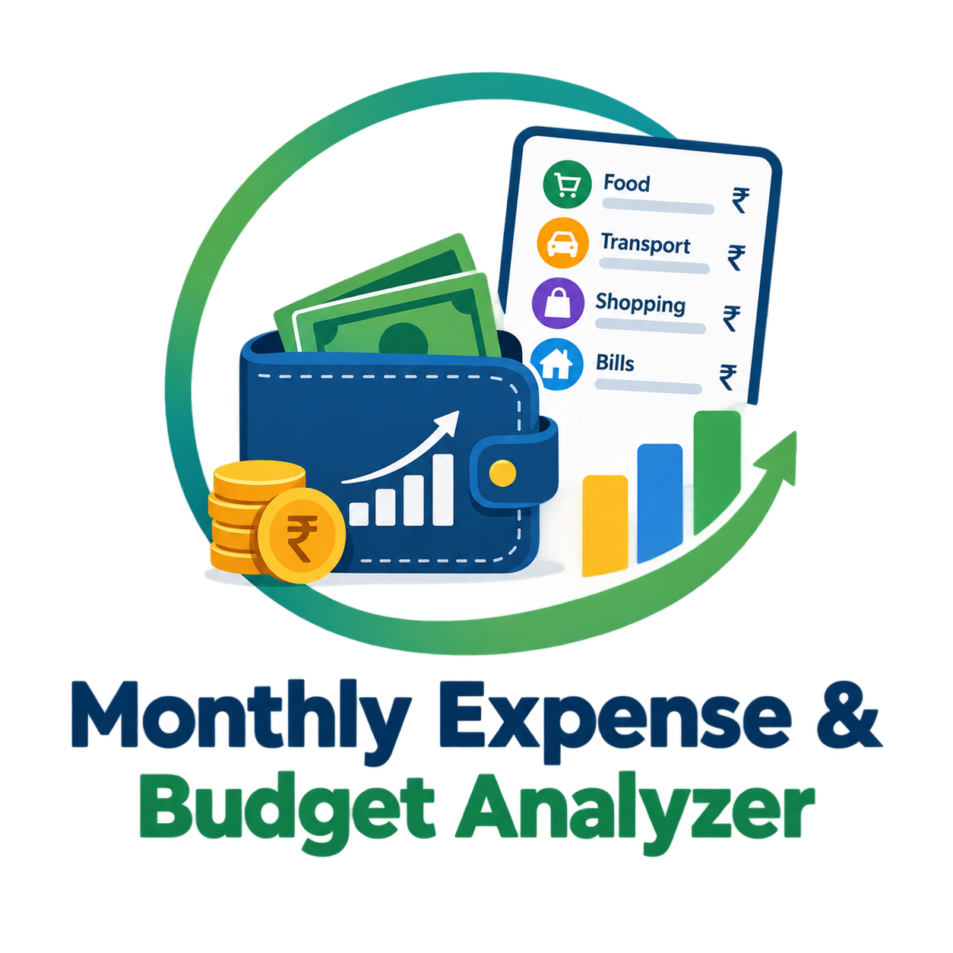
INTRODUCTION
Monthly Expense and Budget Analyzer is a Java application for managing personal finances. It records income, expenses, savings, and monthly budgets, with categories such as Food, Grocery, Shopping, and Transport.
The program models expenses and budgets using classes and objects, protects data through encapsulation, and uses exception handling to manage invalid input. String APIs process descriptions, while file input/output preserves records for future use. Collections and Stream pipelines help summarize category-wise expenses and identify spending patterns.
03

Slide 5
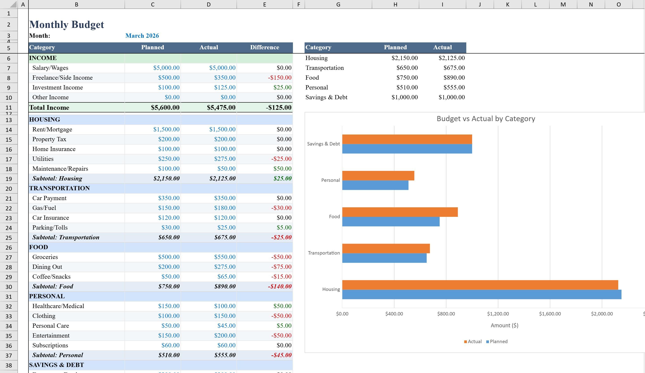
PROJECT OBJECTIVES
Record monthly income and daily expenses using console input.
Calculate total expenses, remaining balance, and savings with arithmetic, methods, and arrays.
Set and monitor budgets for different expense categories using conditions and loops.
Model expense and budget records with classes, objects, encapsulation, and relationships.
Validate input and handle errors using Java exception handling.
Search, sort, compare, and save expense records using String APIs, standard algorithms, and file I/O.
Use Collections, lambdas, functional interfaces, and Streams for category-wise summaries and spending trends.
04

Slide 6

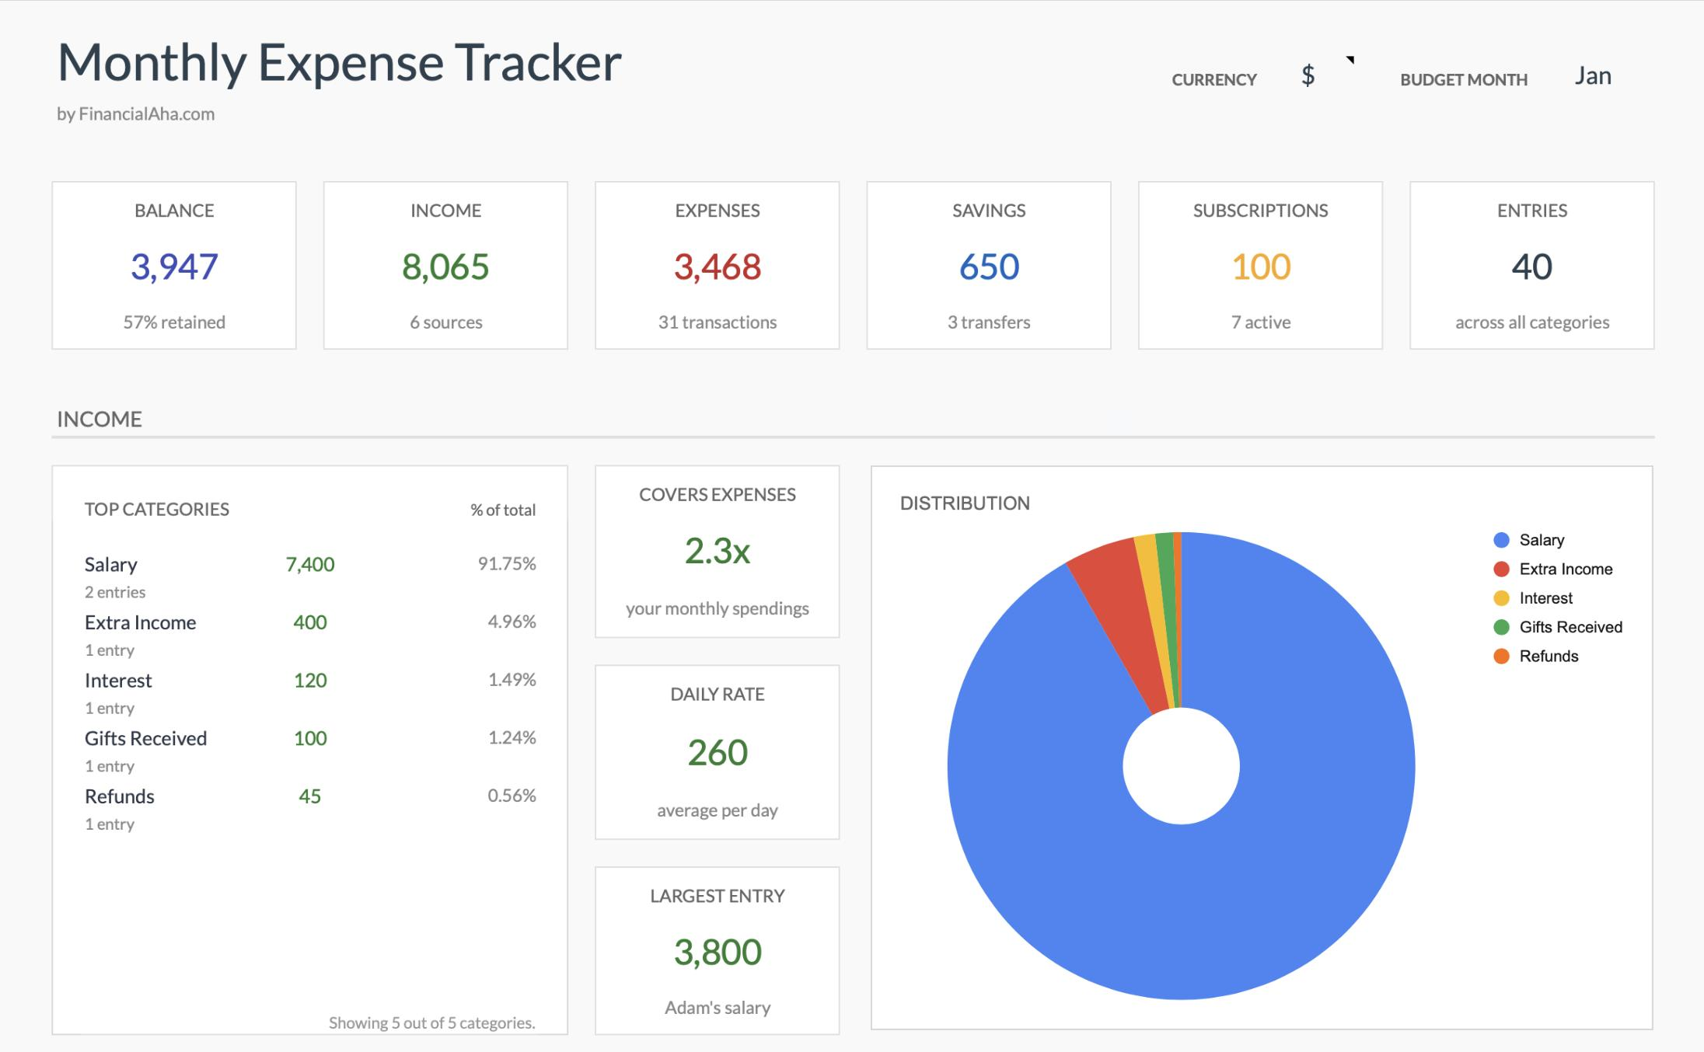
ADVANTAGES
Easy and organized tracking of personal expenses.
Shows remaining balance and total savings clearly.
Uses classes and encapsulation to organize and protect expense data.
Handles invalid entries more safely with exception handling.
Allows expense descriptions and categories to be processed, searched, sorted, and compared.
Saves records in files so previous months can be reviewed.
Uses collections and Stream operations to identify high-spending categories and summarize expenses.
05

Slide 7
COURSE OUTCOMES
CO1 – Translate the budgeting problem into a Java program using primitive types, expressions, arithmetic, and Scanner-based input/output.
CO2 – Use selection and iteration to validate budgets, repeat expense entry, and decide whether spending is within limits.
CO3 – Use methods and arrays to modularize calculations and store/process expense data.
CO4 – Model expenses and budgets with classes and objects, apply encapsulation and relationships, and handle invalid input with exception handling.
CO5 – Process category names and descriptions with String/StringBuilder; search, sort, compare, and persist records using file input/output.
CO6 – Use collections, lambdas, functional interfaces, and Stream pipelines to filter, summarize, and analyze category-wise expenses.
07

Slide 8
CONCLUSION
Helps users track monthly income and expenses easily.
Provides category-wise analysis and identifies high-spending areas.
Uses Java control flow, methods, and arrays for calculations and budget checks.
Organizes records with classes and encapsulation, and improves reliability through exception handling.
Searches, sorts, compares, and saves expense records for future reference.
Uses collections and Stream pipelines to summarize spending trends.
Overall, the project combines CO1–CO6 concepts to support better budgeting and financial planning.
08

Slide 9
FUTURE SCOPE
Add a mobile or web-based interface.
Display charts and graphs for visual spending analysis.
Provide alerts when a category approaches or exceeds its budget.
Improve file storage with secure backups and user login.
Use collections and Stream-based summaries to generate monthly reports.
Extend searching and sorting to compare records across months.
Explore secure cloud storage and bank or digital-wallet integration.
09

Slide 10
THANK YOU

